Slide 1
Interactional and Linguistic Analysis for Computationally Diagnosing Alzheimer’s Disease
Claire Mary Kelleher (MSc. Big Data Science)
Supervisor: Dr./Prof. Matthew Purver

Slide 2
Roadmap
Dementia Intro: Dementia/Alzheimer’s Disease Definition
Motivation
Project Intro: Method
IF Definition
Dataset used
Previous Work
Implementation:
Linguistic Features: Encodement
Feature Selection
Classifier build & accuracy scores
Interactional Features: Encodement
Feature Selection
IF correlation analysis
Results & Discussion
Conclusion
Further work
Questions

Slide 3
Intro: Dementia & Alzheimer’s Disease
Motivation

Slide 4
Dementia & Alzheimer’s Disease (AD)
The word ‘dementia’ describes a set of symptoms that may include memory loss and difficulties with thinking, problem-solving or language.
AD most common type of dementia - affecting 62% of those diagnosed with Dementia
This project focuses on exploring the effects that AD has on both linguistic and interactional skills with the aim of improving the computational diagnosis of AD.

Slide 5
Motivation
After memory loss, language impairment and changes in a patient's behaviour are part of the top symptoms of AD.
A number of studies have already been carried out using computational techniques on linguistic features to diagnosis AD.
However, few studies have been carried out using patient's behaviour as features.
By adding in these extra layer of symptoms, it is hypothesised that the classification of AD will be improved.

Slide 6
Project Intro: Method
IF Definition
Dataset used
Previous Work

Slide 7
Method
Using data derived from the DementiaBank corpus [1], this project looks at how a change in a person's interactional features in conversation can be used to better classify the different diagnosis's of AD and other dementias using NLP methods and other computational techniques.
23 linguistic features were encoded and were used to build the classifier (Based on Fraser et al.)
24 interactional features were encoded
Prediction scores for all of the above were calculated and features ordered by score
Therefore:
H0: Top 23 predicting features are all linguistic based (ie. no change from Fraser et al. features)
HA: If new top features include any of the interactional features, it can be said the the combination of both linguistic and interactional features encoded together outperform the classification of AD than that of when linguistic features are used solely
‘New Top 23’ features were also ran through the classifier to confirm improvement by comparing accuracies.
Correlation between IF’s & target variable (AD diagnosis) was also investigated.
Notes:
Fraser et al. [2] have found the optimal number and strongest predicting features that are linguistic, information content based, that best classify AD.
Features that represent internacional phenomenon were encoded and added to the classifier to investigate if there was improvement in classifier accuracy.

Slide 8
Interactional Features Definition
Interactional features (IF’s) for the purpose of this study is defined as non-linguistic based features that represent a patient's behaviour such as hesitation, word searching techniques and different aspects of dialogue between them and an examiner.
Three umbrella features were created as a hierarchical grouping:
Fillers
Unintentional Silence
Dialogue

Slide 9
Dataset used: TalkBank - DementiaBank
DemBank is lala
Recording of a session
1 transcript per recording, 1 diagnosis (target label) per transcript
Count of 6 target labels
Poss AD & Prob AD merged to All (Vs Ctrl) - other labels ignored

Slide 10
Previous Work
Svennevig and Lind 2016, “Dementia, interaction, and bilingualism: An exploratory case study”
Croisile et al. 1996, “Comparative Study of Oral and Written Picture Description in Patients with Alzheimer’s Disease”
Aphasia therapy dialogues, Silvast, M. 1991
Fraser et al. 2016, “Linguistic Features Identify Alzheimer's Disease in Narrative Speech”
Notes:
Sven def:
Talk about Cookie task
Croisile def:
Fraser def:
Fraser et al. [2] have found the optimal number (35) and strongest predicting features that are linguistic and information content based (non-interactional), that best classify AD.
Aphasia therapy dialogues, Silvast, M. Investigates the interaction between aphasiac patients and the speech therapist in order to investigate the role of the therapist when using conversation as a method for rehabilitating aphasic patients. Aphasia, is the inability to understand or produce speech and has been a proven symptom of AD [14].

Slide 11
Previous Work
Svennevig and Lind 2016, “Dementia, interaction, and bilingualism: An exploratory case study”
Croisile et al. 1996, “Comparative Study of Oral and Written Picture Description in Patients with Alzheimer’s Disease”
Aphasia therapy dialogues, Silvast, M. 1991
Fraser et al. 2016, “Linguistic Features Identify Alzheimer's Disease in Narrative Speech”
Notes:
Sven def:
Talk about Cookie task
Croisile def:
Fraser def:
Fraser et al. [2] have found the optimal number (35) and strongest predicting features that are linguistic and information content based (non-interactional), that best classify AD.
Aphasia therapy dialogues, Silvast, M. Investigates the interaction between aphasiac patients and the speech therapist in order to investigate the role of the therapist when using conversation as a method for rehabilitating aphasic patients. Aphasia, is the inability to understand or produce speech and has been a proven symptom of AD [14].

Slide 12
Linguistic Features: Encodement
Feature Selection
Classifier build & accuracy scores

Slide 13
Linguistic features from Fraser et al. were re-encoded and used as a baseline of evaluation for this project model
Semantic Impairment
Syntactic Impairment
Information Impairment
Acoustic Impairment

Slide 14
Linguistic features from Fraser et al. were re-encoded and used as a baseline of evaluation for this project model
Semantic Impairment: POS tag frequency, Honore's Statistic, Repetition measure by cosine difference, PCFG Parsings
Syntactic Impairment
Information Impairment

Slide 15
Linguistic features from Fraser et al. were re-encoded and used as a baseline of evaluation for this project model
Semantic Impairment: POS tag frequency, Honore's Statistic, Repetition measure by cosine difference, PCFG Parsings
Syntactic Impairment: Not in Dictionary, Verbs rate, PCFG parsings
Information Impairment

Slide 16
Linguistic features from Fraser et al. were re-encoded and used as a baseline of evaluation for this project model
Semantic Impairment: POS tag frequency, Honore's Statistic, Repetition measure by cosine difference, PCFG Parsings
Syntactic Impairment: Verbs rate, PCFG parsings, Not in Dictionary
Information Impairment: Count of keywords, Information units

Slide 17
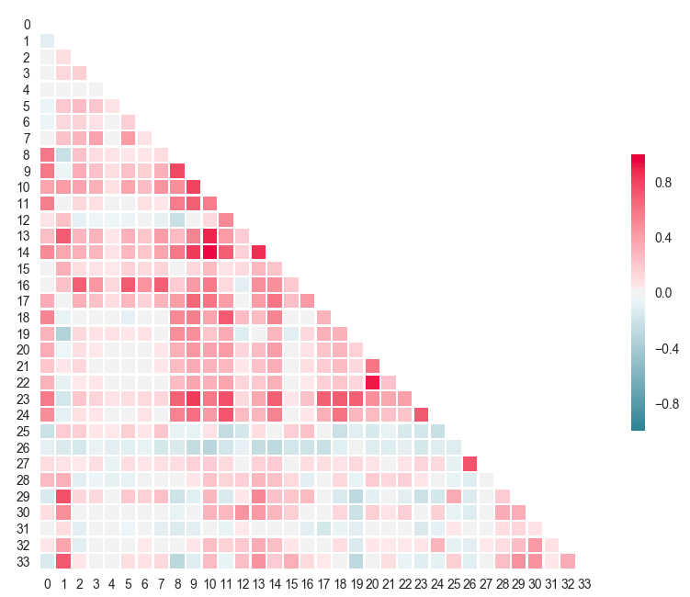
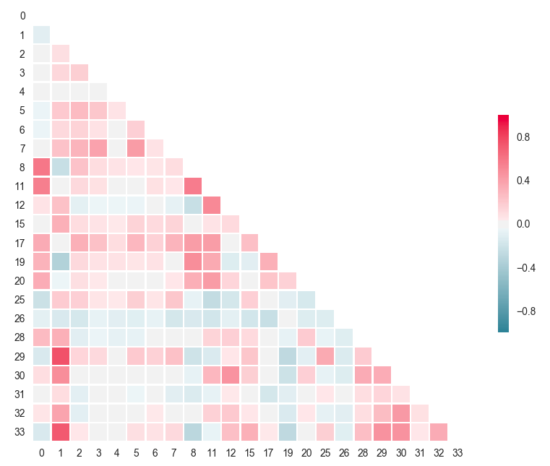
Linguistic features selection was based on the reduction of correlation between variables.
Post-FS (34)
Post-FS (23)
Correlation
(-1,+1)
LF correlation matrix pre FS
LF correlation matrix post FS

Slide 18
The Fraser model was rebuilt with 23 linguistic features resulting in similar accuracies allowing it to be used as a baseline for evaluation.
These features were used to replicate the model built in Fraser et al.
Same dataset used
Logistic Regression, accuracy scores of ~80%
This project's model rebuild resulted in PRF scores of:
Classifier | Precision | Recall | F1 Score
Logistic Regression | 77.5% | 72.3% | 73.8%

Slide 19
Interactional Features: Encodement
Feature Selection
Correlation with Diagnosis

Slide 20
Interactional features were then encoded based on 3 umbrella features and added to the model to evaluate change in accuracies
Fillers
Utilized to fill the lexical gap when production of speech is impaired
For example: “um”, “like”, “uh”, “you know!” and “actually.”
2. Unintentional Silence
Similar reasoning for occurring as fillers such however, instead of trying to fill the lexical gap, the void in conversation is left as it is.
3. Dialogue
This umbrella feature was created to represent phenomenon between the participant and the examiner that based on the conversation dominance.
Notes:
Fillers:
Individuals with dementia of the Alzheimer’s type often experience, word retrieval problems (anomia) and typically as the disease progresses, the patient's production of speech decreases (aphasia) and the use of empty phrases, speech automatisms increases, where fillers tend to be used to fill in the lexical gap [4].
This umbrella feature was used to represent when a moment of silence occurred or an utterance was interrupted or terminated unintentionally. This can happen for a number of reasons such as the participant losing concentration or forgetting what they were supposed to be doing

Slide 21
A total of 24 Interactional Features were encoded
Fillers: Total Filler Frequency, POS tags post filler, ‘Filler Location’ Score, Average cosine similarity of post filler term, Self-correction counts, Sighs, Laughs, ‘I don’t know’ counts, Unintelligible words
2. Unintentional Silence
3. Dialogue

Slide 22
A total of 24 Interactional Features were encoded
Fillers: Total Filler Frequency, POS tags post filler, ‘Filler Location’ Score, Average cosine similarity of post filler term, Self-correction counts, Sighs, Laughs, ‘I don’t know’ counts, Unintelligible words
2. Unintentional Silence: pause lengths (long, medium, short), trailed off mid-utterance,
Incomplete words
3. Dialogue

Slide 23
A total of 24 Interactional Features were encoded
Fillers: Total Filler Frequency, POS tags post filler, ‘Filler Location’ Score, Average cosine similarity of post filler term, Self-correction counts, Sighs, Laughs, ‘I don’t know’ counts, Unintelligible words
Unintentional Silence: pause lengths (long, medium, short), trailed off mid-utterance,
Incomplete words
3. Dialogue: Backchannels, Questions frequency of both the examiner
& participant, Answer Length, Turn Count Ratio, “I don’t know”

Slide 24
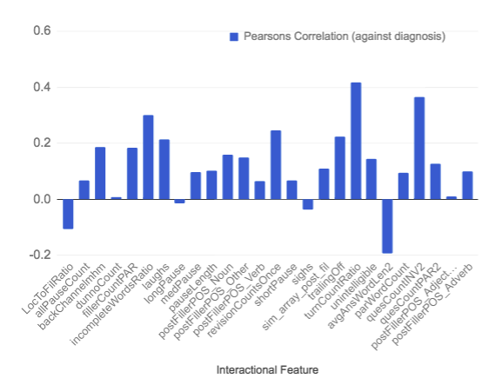
The two variables that have the highest Pearson’s Correlation with the target variables (Probable AD) are the utterance start count ratio (Examiner / Participant) and a normalised frequency of examiner questions.
It is suggest that the 3rd highest correlating variable (participant incomplete word ratio) causes the above two variables.
Eg. A participant fails to complete word therefore the examiner needs to clarify what they’re trying to express by asking more questions and therefore having an increase count in utterance starts.*
*TTR & EQC have a correlation of ~0.2

Slide 25
Results & Discussion, Conclusion, Further Work

Slide 26
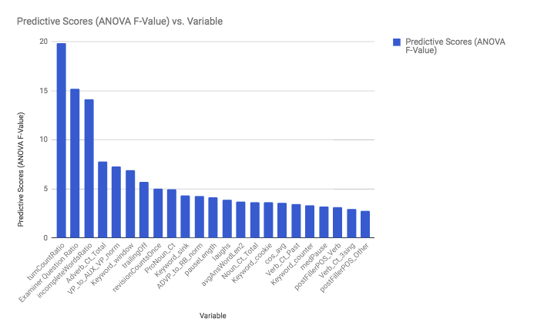
Over half (52.2%) of the originally all linguistic features (red) were replaced by ones that were interactional (blue) disproving the null hypothesis.
There it can be said that the combination of both linguistic and interactional features encoded together outperform the classification of AD than that of when linguistic features are used solely.

Slide 27
Not only did interactional features replace over half of the linguistic features in the top predicting feature ranking, the top 3 features were interactional and had a significantly higher prediction score than the remaining variables.
Change colour of bars - highlight top 3

Slide 28
Echoing the correlation analysis results, the three variables that have a significantly higher predicting scores (ANOVA F-Value) than the remaining features are Turn-Take Ratio (TTR), Examiner Question Ratio (EQC) and Incomplete Word Ratio (ICR).
The combination of these three variables having a significantly higher predictive scores suggest that the phenomenon of the examiner being required to manifest a role of higher dialogue and presence can be represented by encoding these features and used to aid the computational diagnosis of AD.
Change colour of bars - highlight top 3

Slide 29
As expected, the addition of interactional features saw was an increase (+4.96%) in classifier accuracy.
 | LF Only | LF & IF | Absolute Difference
Precision | 77.5% | 82.46% | +4.96%
Recall | 72.3% | 78.16% | +5.82%
F1 Score | 73.8% | 79.36% | +5.54%

Slide 30
Conclusion
Since interactional features replaced over half of the originally all non-interactional top predicting features regarding diagnosis predicting weight, as well as causing an improvement in the classifier's accuracy, one can conclude that encoding interactional features, in particular dialogue based features that represent the amount of involvement the invigilator is required to manifest throughout the session, in addition to non-interactional features, can assist in computationally classifying Alzheimer's disease.

Slide 31
Further Work
The results suggest that dialogue plays a key role in the classification of AD therefore further investigation would include investigating variables created focusing on dialogue and running the data through a DA tagger.
It would have also been beneficial to use a different data set, other than recording of the ‘Cookie Theft’ test. This is because other tests include more interaction between participant and examiner. Eg. Sentence, Recall,Fluency* tests - potentially carry out.
The definition of self-repair (CHAT annotation) that was used was in the top predicting variables. Further study would include running the data through a self-repair detector (STIR). Using the similar features that were created throughout this project. Cosine difference between word that needed repairing and intended words (could be a measure of the mistake made?)
Analysis of features that predict other NON-AD diagnosis, moving away from classification, maybe using anomaly detection as there is very much data.
*These are on DementiaBank however, there is no control therefore proxy controls would have to be created.

Slide 32
Questions?

